Slide 1
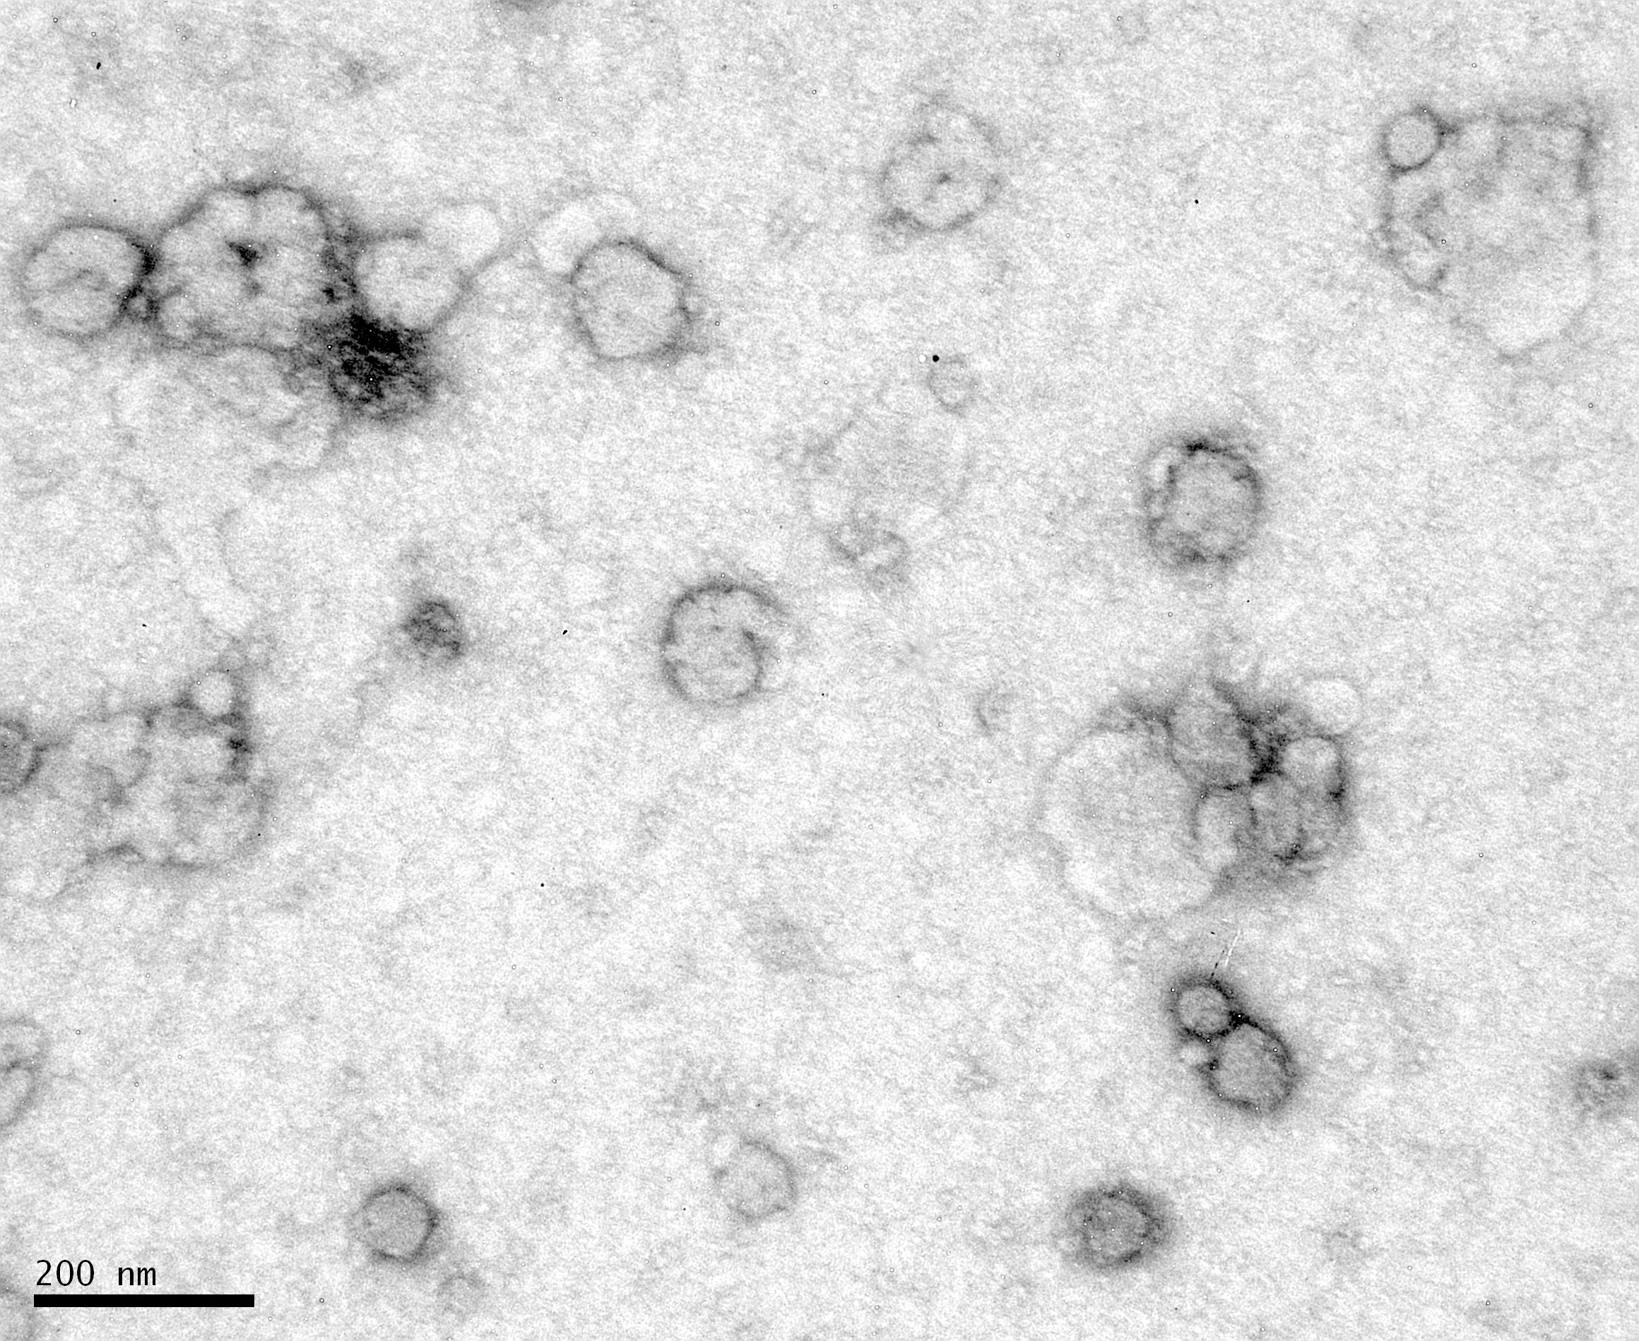

Introduction to Extracellular Vesicles
Angelica Ortiz, PhD
Assistant Professor
NYU School of Medicine
Department of Environmental Medicine

Slide 2
Outline
Introduction and History
Methods of Isolation and Characterization
Metal exposure alters extracellular vesicles that induce inflammation and participate in cancer progression
Extracellular vesicles as effectors of disease, targets for therapy, and possible source for therapy

Slide 3
I. Introduction and History

Slide 4
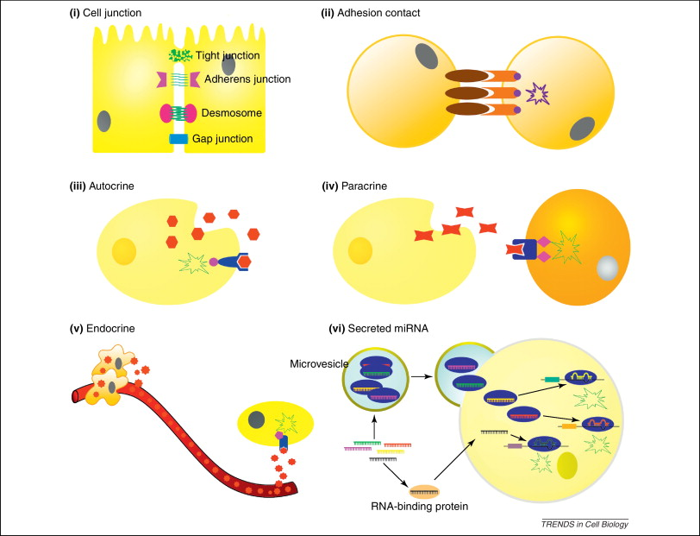
Cell communicate in various ways
What are the soluble factors released by cells that mediate autocrine, paracrine and endocrine communication between cells?

Slide 5
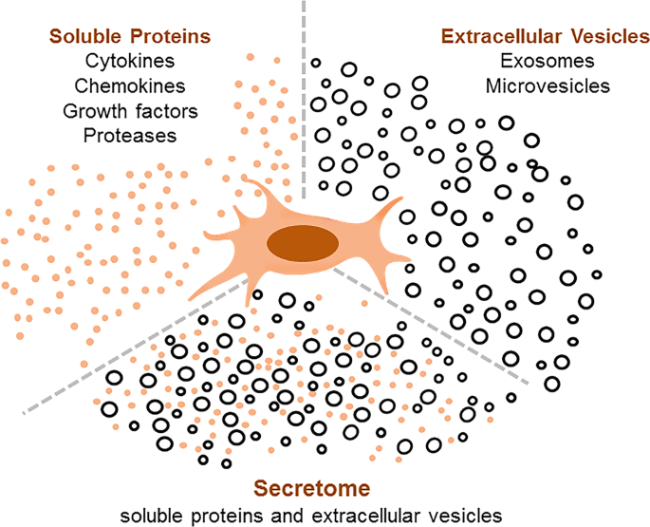
Extracellular Vesicles: Novel Component of Cellular Secretome
Journal of Gastroenterology volume 54, pages763–773 (2019)

Slide 6
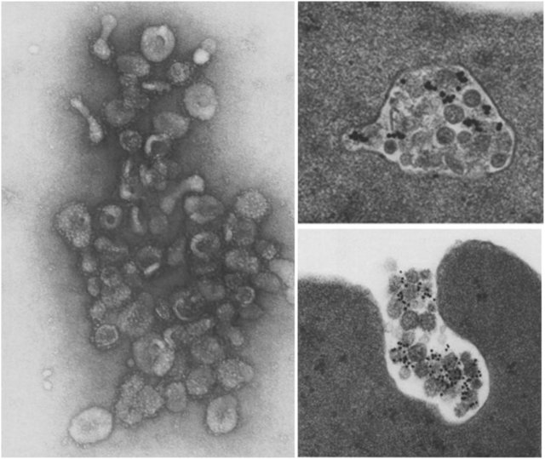
Extracellular Vesicles first observed in 1983
Bin-Tao Pan and Rose M Johnstone at McGill University (Canada) were following changes of Transferrin receptor during the in vitro maturation of sheep reticulocytes. Transferrin receptors were labeled FITC and I-125 anti-Transferrin receptor antibodies to follow the fate of the receptors. Rather than observing endocytosis and intracellular degradation of the receptors, they observed packaging of the receptors into vesicles that were then secreted into extracellular space. This process was considered a pathway for cells to expel unwanted or unnecessary material.
Pan et al. 1985
Cell, Vol. 33, 967-977, July 1983
J Cell Biol 101(3):942–948
Pan and Johnstone 1983
Pan et al. 1985

Slide 7
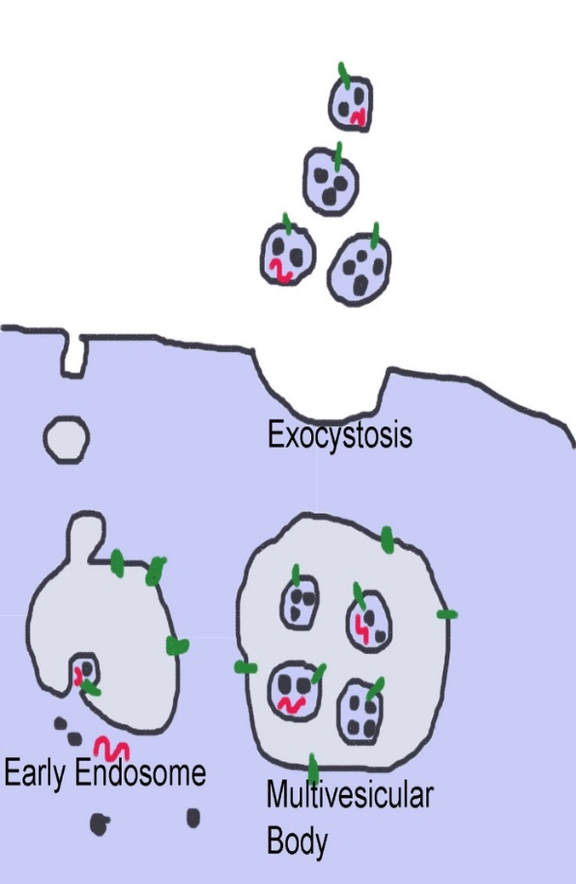
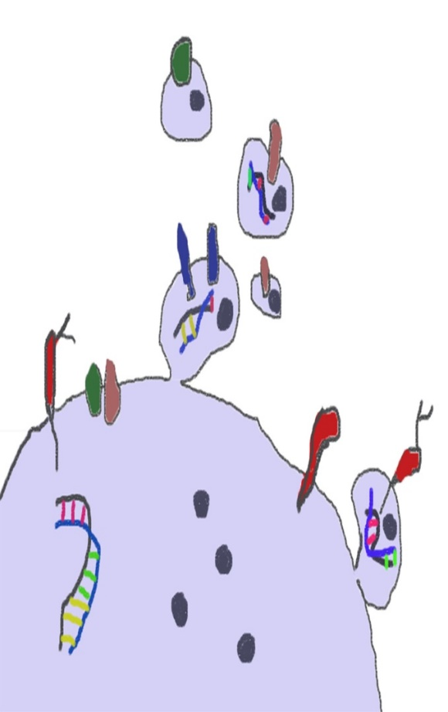
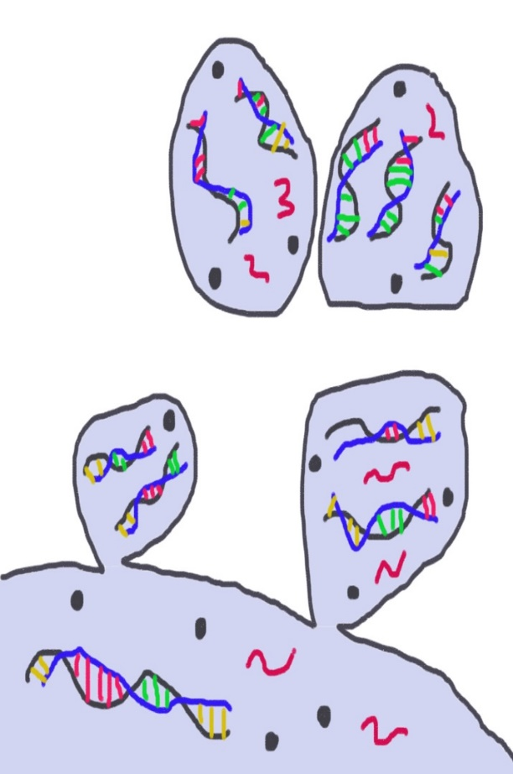
What are extracellular vesicles?
Exosomes
Microvesicles
Apoptotic Bodies
Diameter:
30 nm to 150 nm
About the size of viruses
Diameter:
100 nm to 1 µm
About the size of bacteria and protein aggregates
Diameter:
1 µm to 5 µm
About the size of platelets
Notes:
Extracellular vesicles are nanoparticles released by cells during cellular life cycle to maintain tissue and systemic homeostasis. They are a heterogenous population of varying sizes. The smallest are exosomes and the largest are apoptotic bodies.

Slide 8
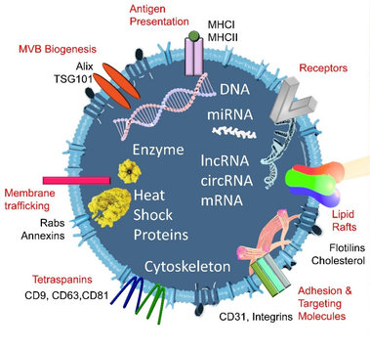
Contents carried by Extracellular Vesicles
Chang et al. July 2021. Biomedicines; 9 (8): 931
Notes:
Extracellular vesicles released can be incorporated by recipient cells or function as ligands for receptors as a means of intercellular communication. If the parent cell is corrupt (responding to inflammation, mechanical/chemical injury, genetic aberration), the messages carried by their vesicles can spread the corruption to neighboring and distant cells.

Slide 9
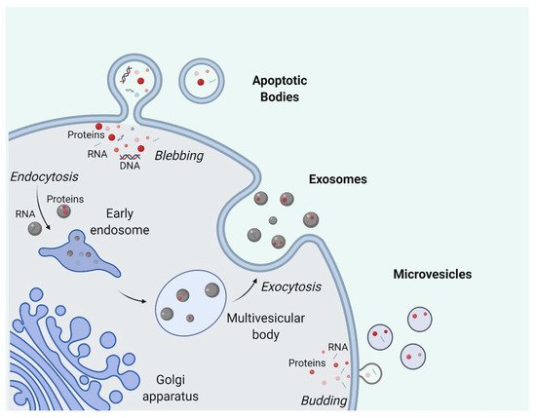
Origin of Various Types of Extracellular Vesicles
Markers to identify Exosomes:
Alix
TSG101
Flotillin
CD81
CD9
CD63
HSPA8
HSC70
Markers to Identify Microvesicles:
Integrins
Selectins
Cell-specific markers (e.g. platelet CD154)
TSG101
CD40
>1000 nm
30-100 nm
100-1000 nm
Dang et al. Cells 2020, 9 (10): 2191.

Slide 10
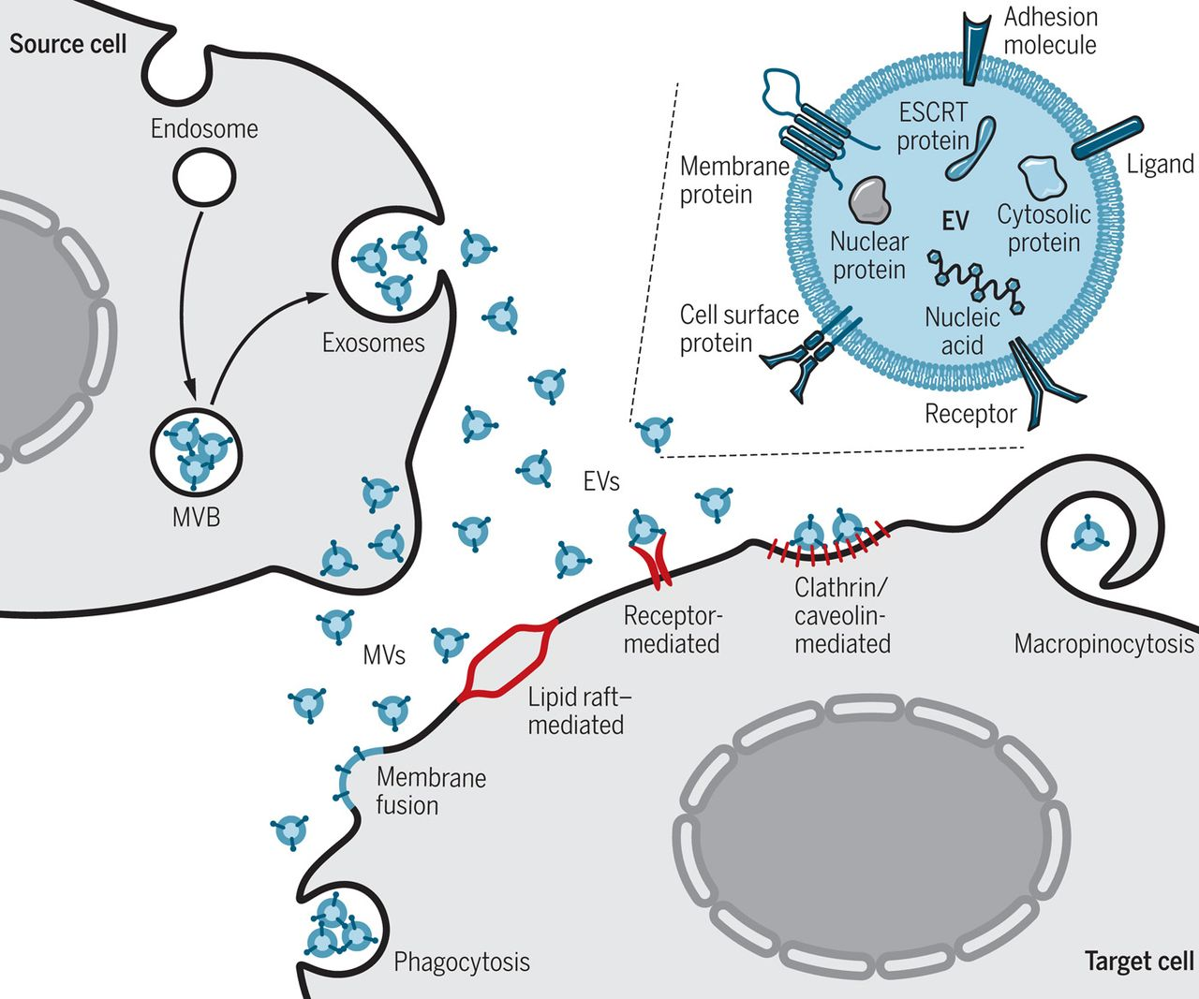
Recipient cells process Extracellular Vesicles via various routes
Extracellular vesicles can activate signaling pathways in recipient cells by:
Functioning as ligands
Activate lipid raft signaling
Incorporate internal cargo via active and passive uptake
Extracellular vesicle cargo once incorporated:
Activates in receptors, such as TLRs
Release protein, microRNA and/or mRNA to activate or dampen cellular function to maintain homeostasis
Wiklander et al. Science Translational Medicine. 15 May 2019. Vol 11, Issue 492

Slide 11
II. Methods of Isolation and Characterization

Slide 12
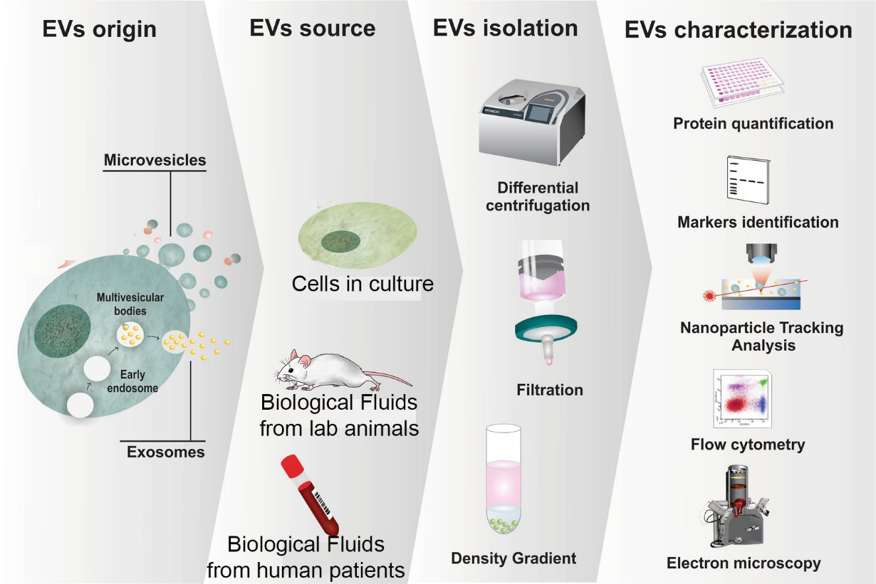
Extracellular Vesicle Research

Slide 13
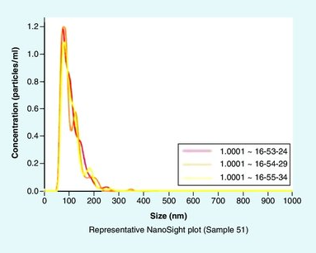
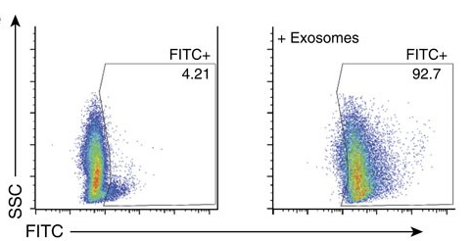
Nanoparticle Tracking Analysis (NTA) and Flow Cytometry

Slide 14
Transmission Electron Microscopy (TEM)

Slide 15
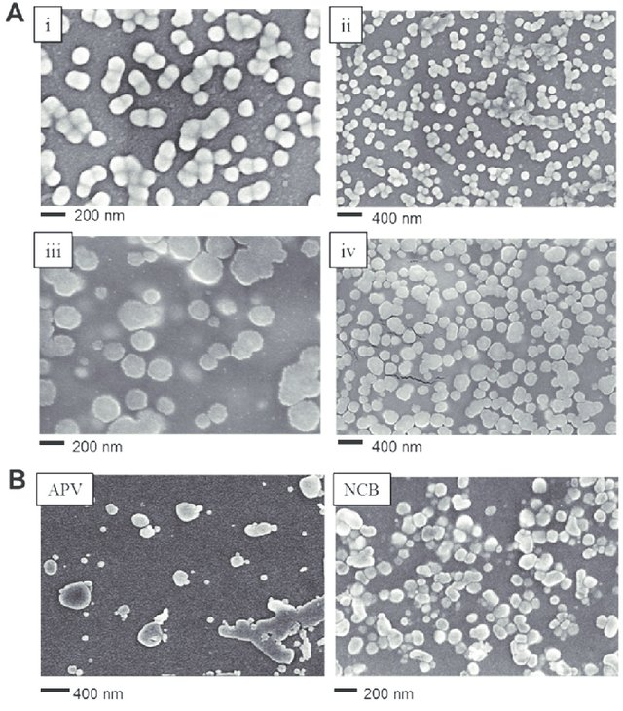
TEM Imaging Used to Examine Morphology, Size, and Shape
Exosomes (EXO) isolated from B16F0 mouse melanoma cells (subpanels i and ii) and SKBR3 human breast cancer cells (subpanels iii and iv) were imaged by SEM.
Extracellular vesicles isolated from apoptotic B16F0 cells that were treated with 7-ethyl-10-hydroxycamptothecin (left panel, apoptotic vesicles APV). Necrotic bodies (NCB) were isolated from B16F0 cells following exposure to high shear conditions (right panel). APV and NCB were imaged by SEM.
Wu et al. September 2015. The Analyst. 140 (19).

Slide 16
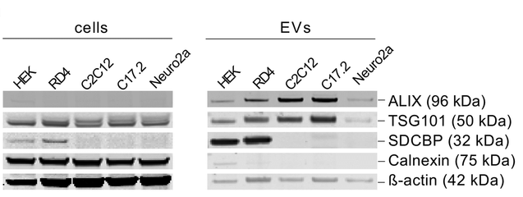
Western Blot Analysis to Determine Origin and Content
Sork et al. Scientific Reports. July 2018. 8 (1).

Slide 17
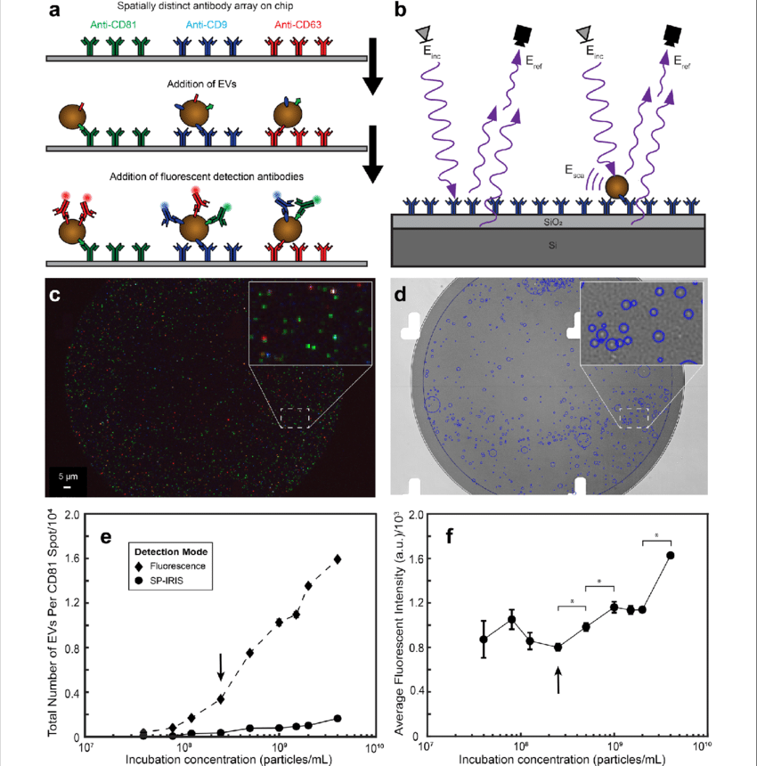
ExoView: Full Characterization of EVs from biofluid without need for isolation
Journal of Nanobiotechnology. August 2021; 19 (1).

Slide 18
III. Metal exposure alters extracellular vesicles that induce inflammation and participate in cancer progression

Slide 19
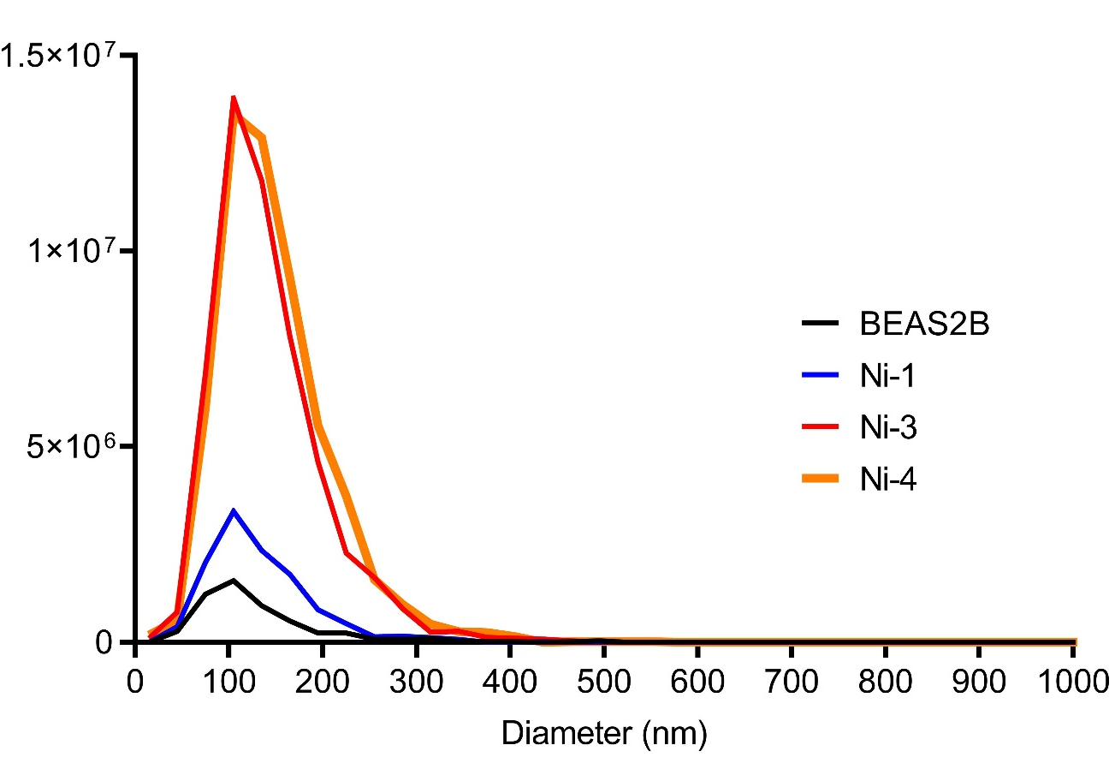
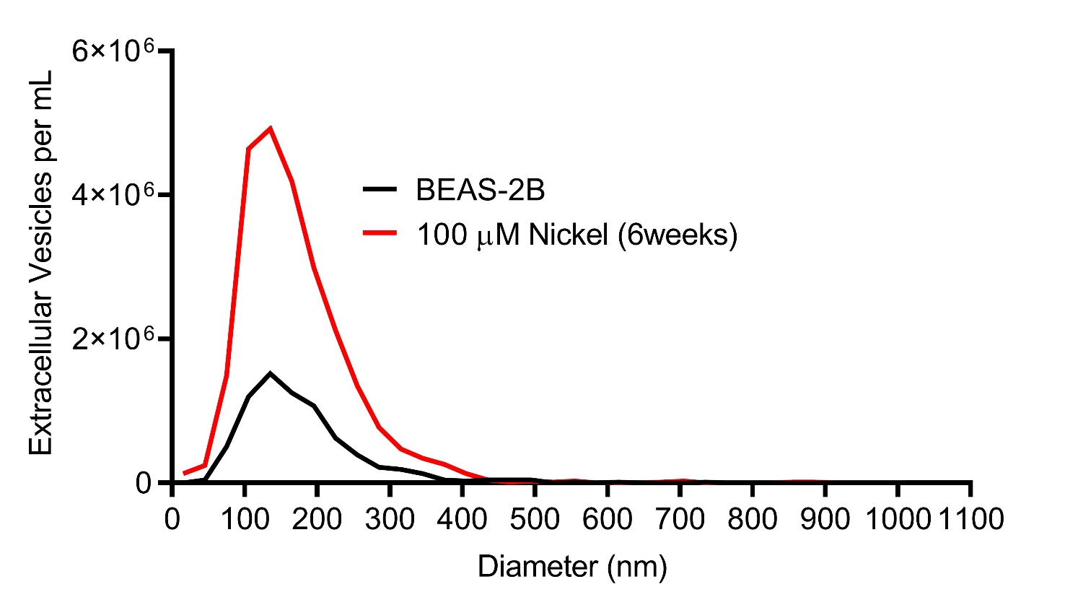
Nickel-induced transformation or prolonged exposure increase release of extracellular vesicles
Angelica Ortiz and Shan Liu

Slide 20
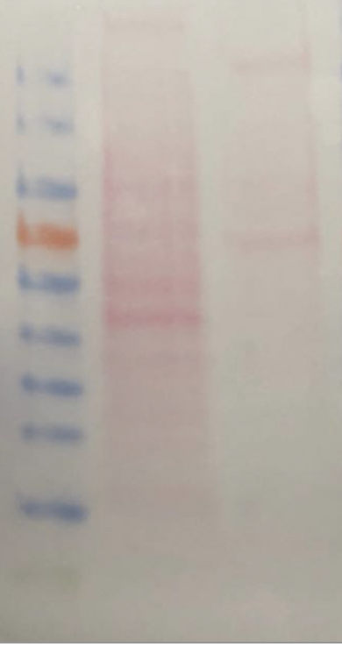




Validation of Ni3 derived EVs by identifying extracellular vesicle markers
Ni3 cell lysate
Ni3 EVs
Ni3 cell lysate
Ni3 EVs
10 ug
Alix
(95KD)
180
130
100
Flotillin
(49KD)
70
55
CD9
(24KD)
40
35
25
GAPDH
15
10
Shan Liu

Slide 21
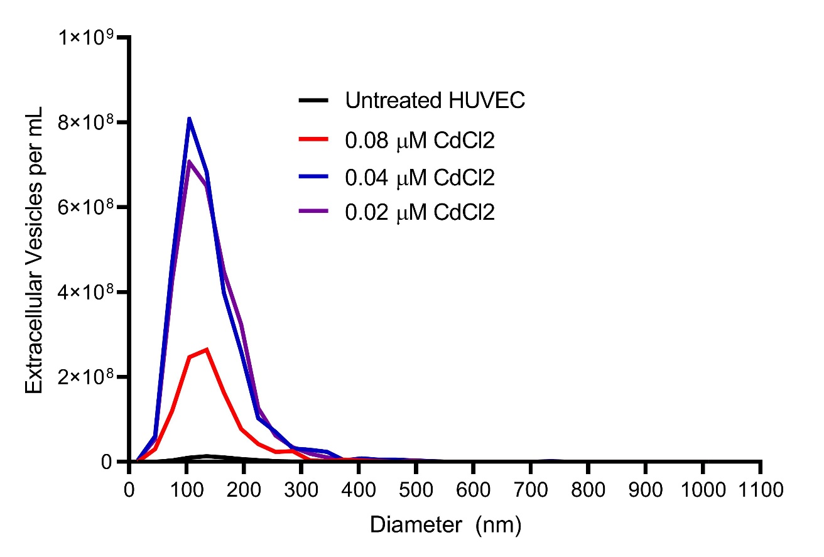
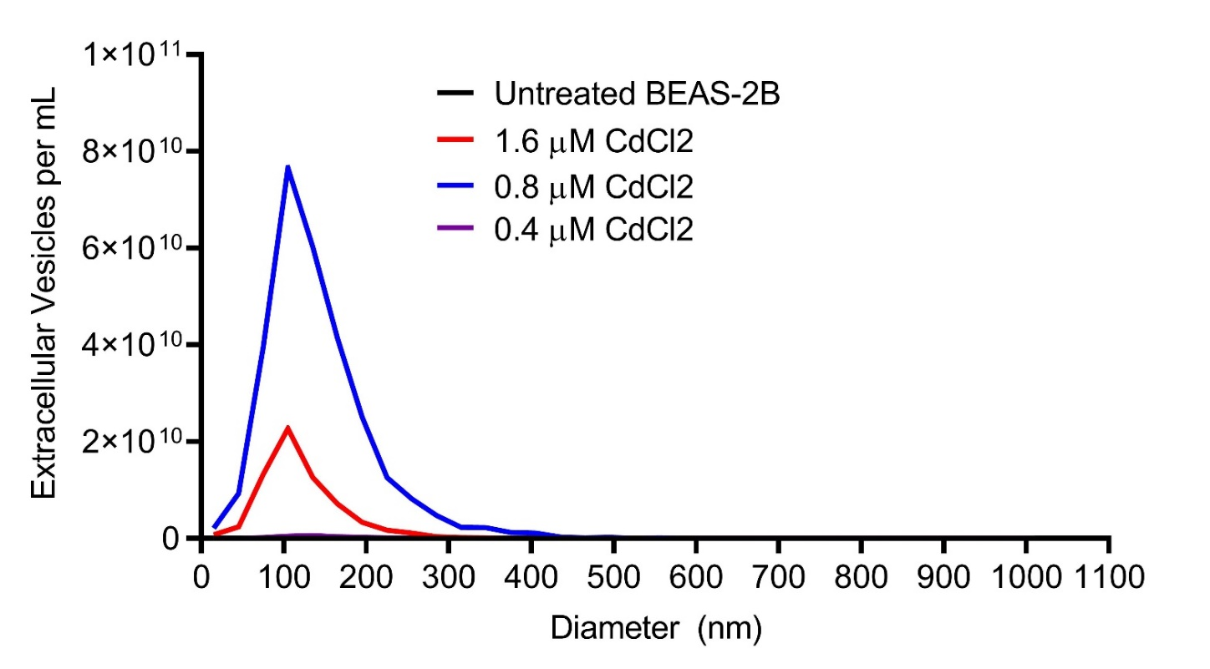
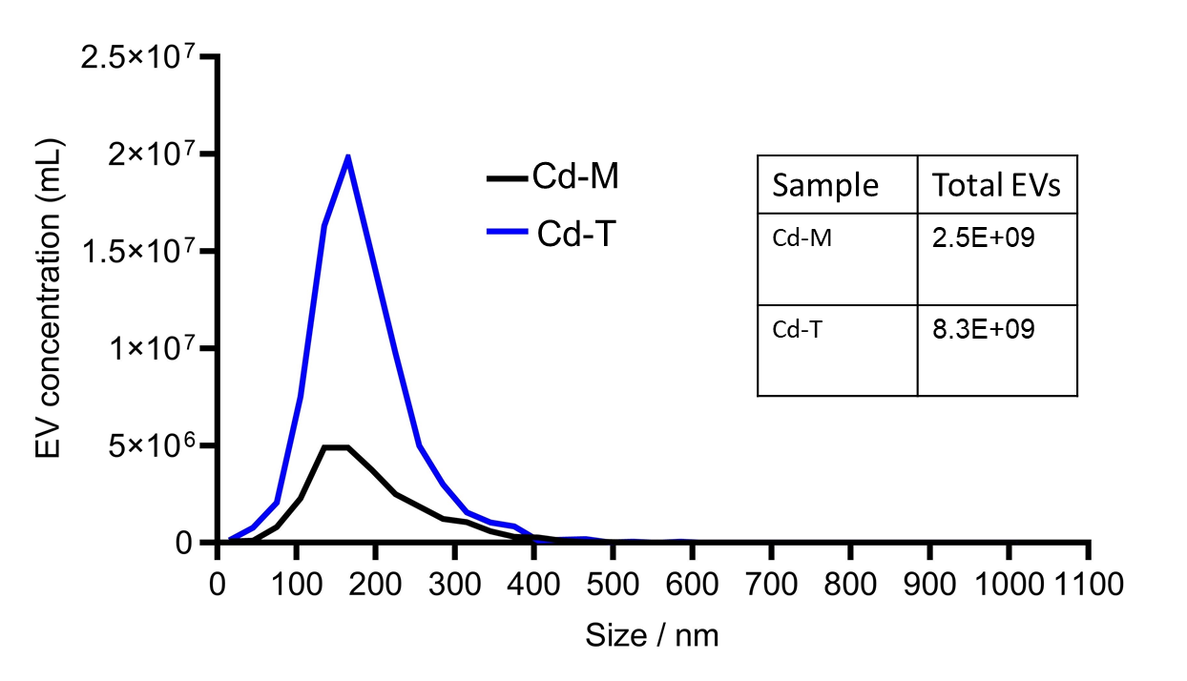
Cadmium Increase Extracellular Vesicle Release
Aikaterini Stavrou

Slide 22
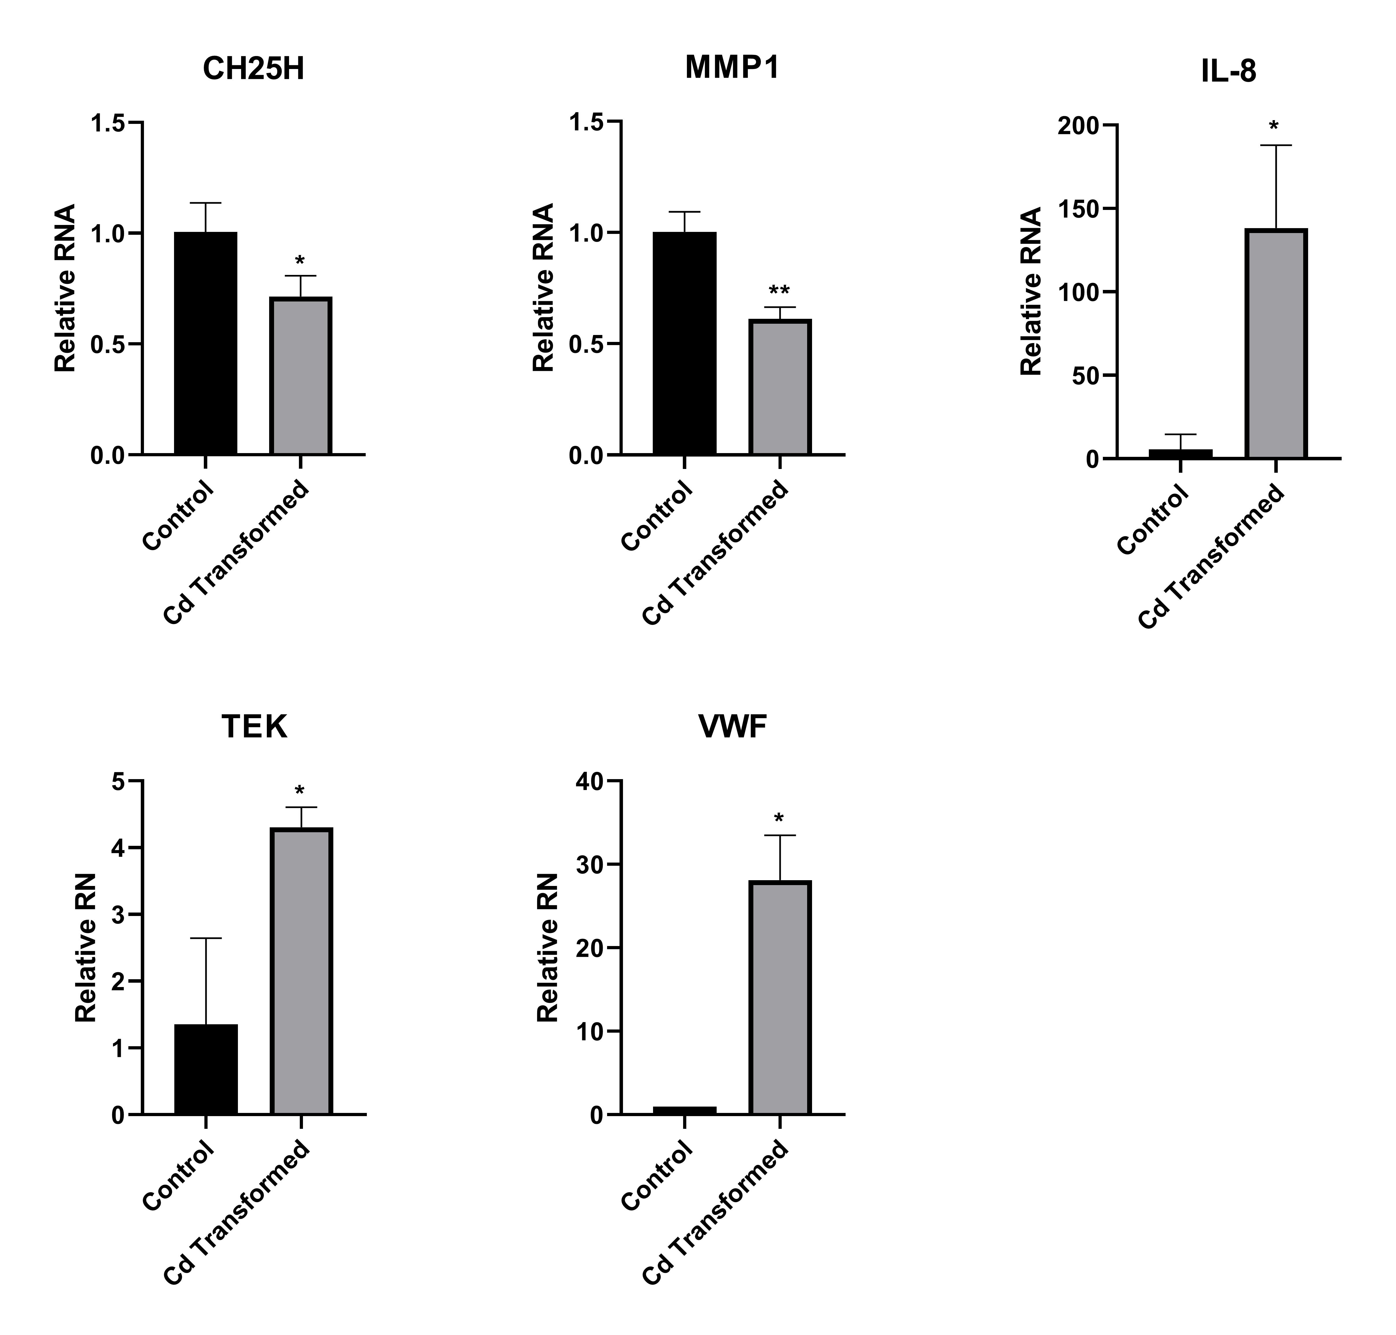
Extracellular vesicles from cadmium transformed cells induce expression of coagulation and inflammatory genes in endothelial cells
Human umbilical vein endothelial cells (HUVEC) were treated with PBS or 10 ug of EVs from Cd Transformed cells for 4 hours.
Aikaterini Stavrou

Slide 23
IV. Extracellular vesicles as effectors of disease, targets for therapy, and possible source for therapy

Slide 24
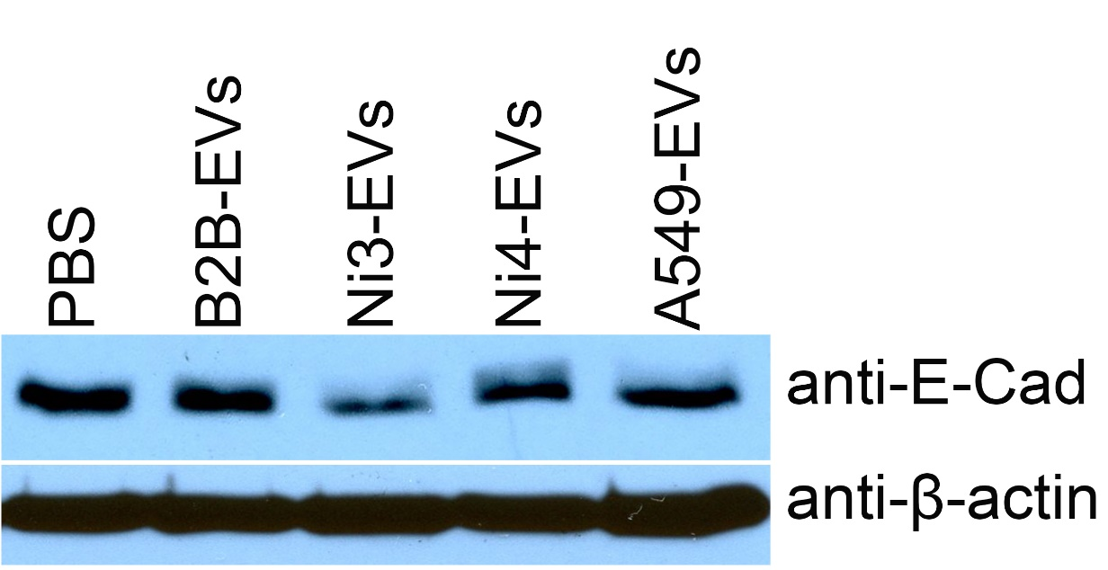
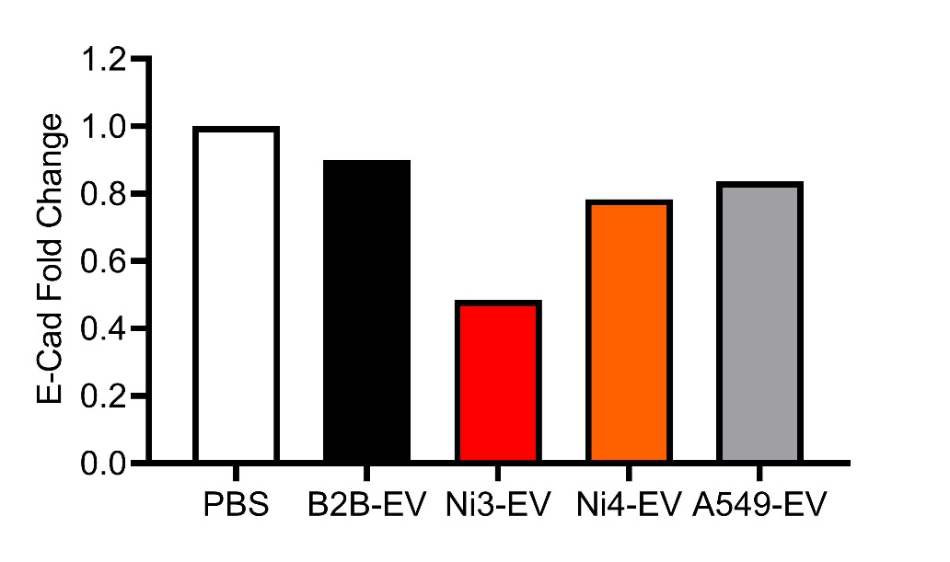
Short-term exposure to metal-altered extracellular vesicles reduces E-cadherin protein level
BEAS2B cells treated with PBS or 5 ug of EVs from Ni3, Ni4, or A548 cells every 24 hr for 5 days before lysis in RIPA buffer.
Angelica Ortiz

Slide 25
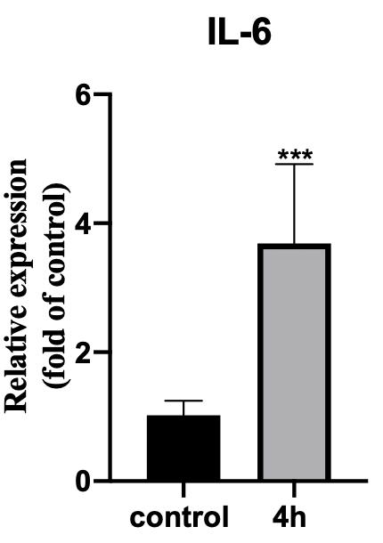
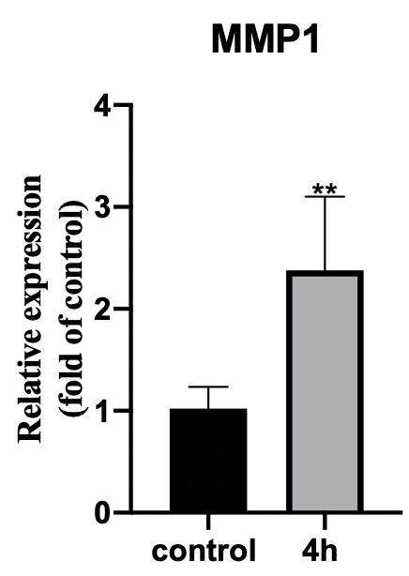
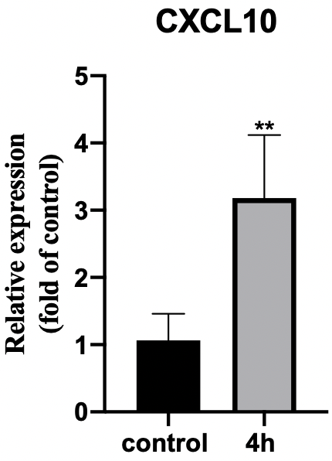
Short-term exposure to metal-altered extracellular vesicles induce expression of inflammatory markers
BEAS-2B cells treated with PBS or 10 ug of Ni3 EVs
Shan Liu

Slide 26
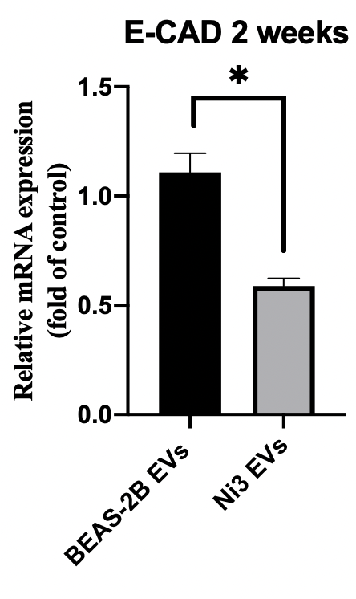
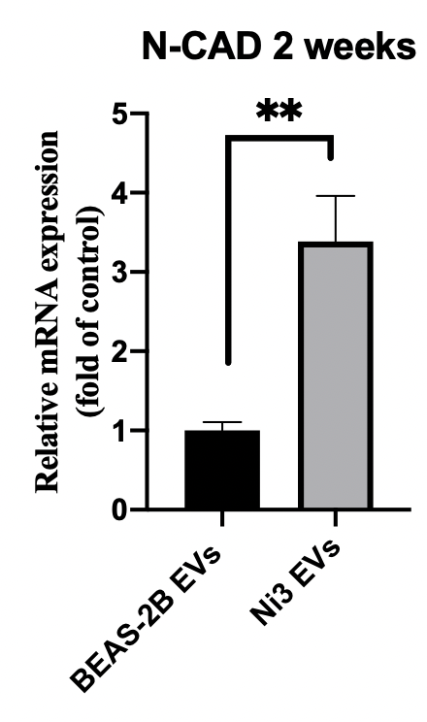
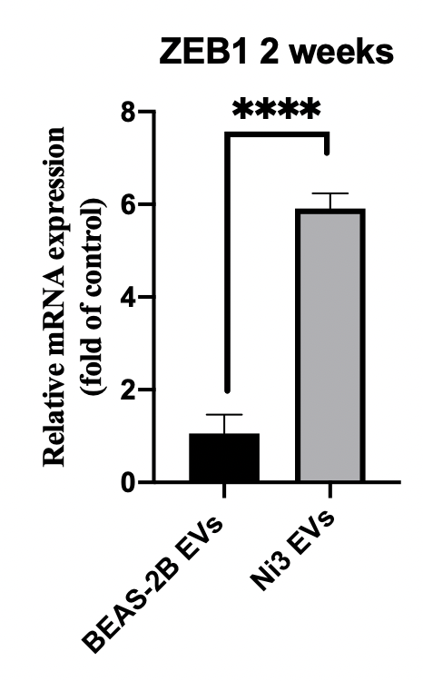
Prolonged Treatment with Extracellular Vesicles from Nickel Transformed Cells Induces Expression of EMT Markers but Extracellular Vesicles from Normal Cells Do Not
BEAS-2B cells treated with 10 ug of BEAS-2B or Ni3 EVs every 24 hrs for 2 weeks
Shan Liu
Notes:
Cells were cultured in BEGM
BEAS-2B EVs from BEAS-2B cultured in 10% FBS, DMEM

Slide 27
Extracellular vesicles from cadmium transformed cells induce expression of coagulation and inflammatory genes in endothelial cells
Human umbilical vein endothelial cells (HUVEC) were treated with PBS or 10 ug of EVs from Cd Transformed cells for 4 hours.
Aikaterini Stavrou

Slide 28
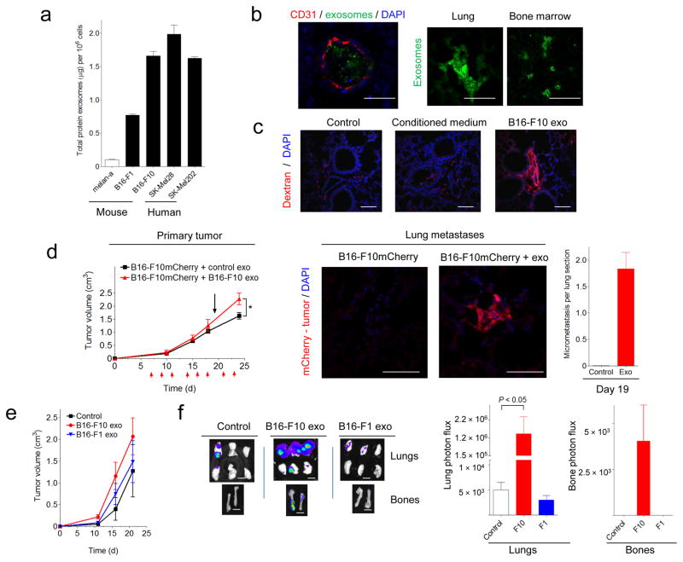
Cancer-derived extracellular vesicles promote tumor growth and metastasis
Nat Med. 2012 Jun; 18(6): 883–891.

Slide 29
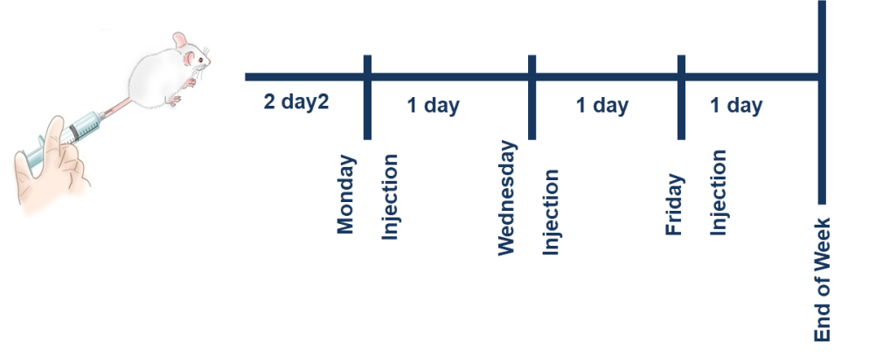
Cancer-derived extracellular vesicles generate pre-metastatic niche in animals in the absence of tumor
Cancer Cell. 2019 Jan 14;35(1):33-45

Slide 30
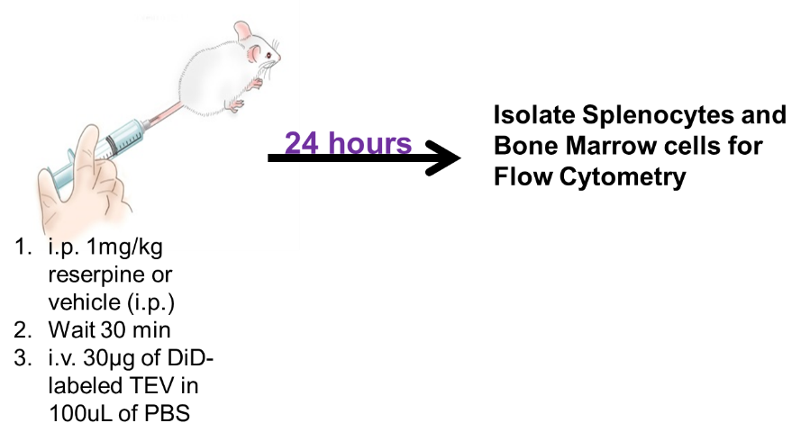
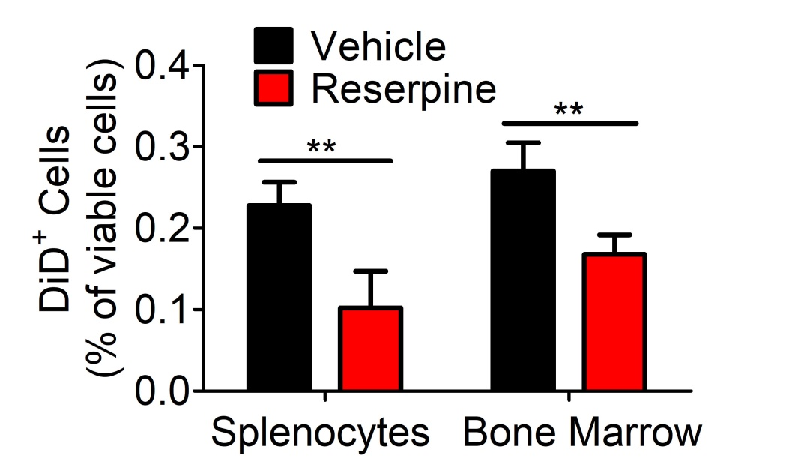
Targeting Extracellular Vesicles: Suppressing Uptake
Cell pre-treated wit 10µM of each drug for an hour before treatment with DiD-labeled B16F10 vesicles for 4 hours for flow cytometry analysis.
Cancer Cell. 2019 Jan 14;35(1):33-45

Slide 31
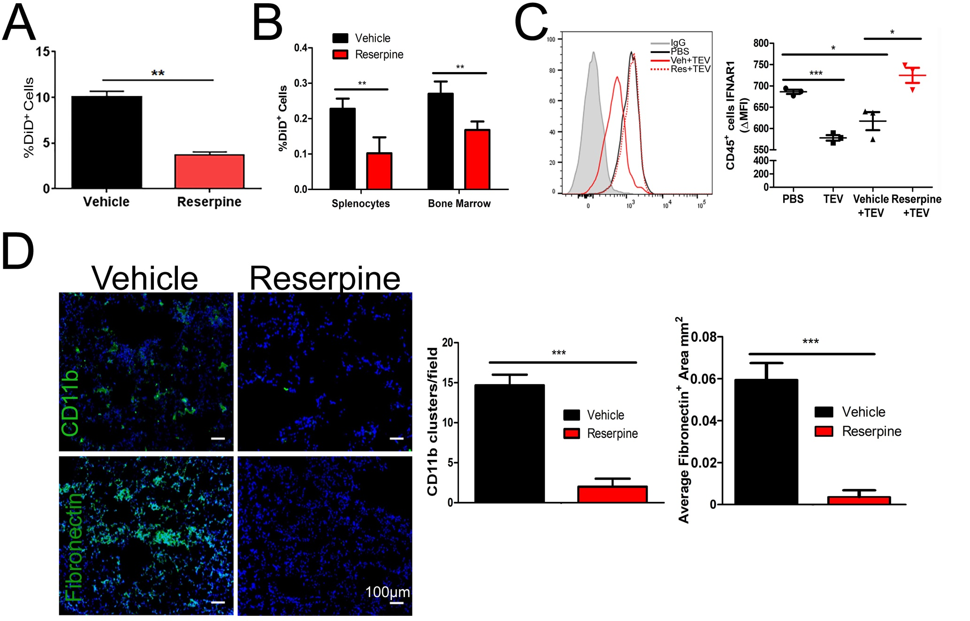

Suppressing Extracellular Vesicle Uptake Inhibits Formation of Pre-metastatic Niche
Cancer Cell. 2019 Jan 14;35(1):33-45

Slide 32
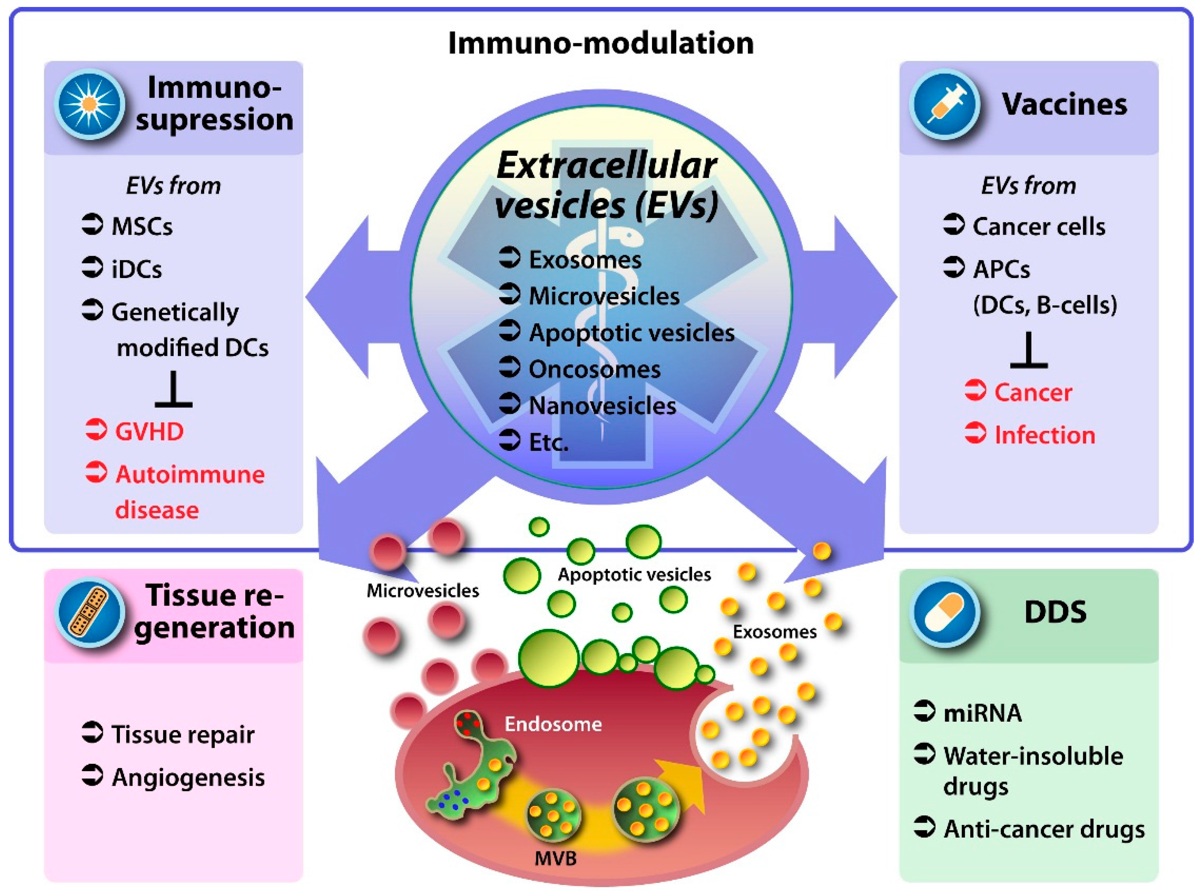
Using Biological Extracellular Vesicles as Therapy
Int. J. Mol. Sci. 2016, 17(2), 172

Slide 33
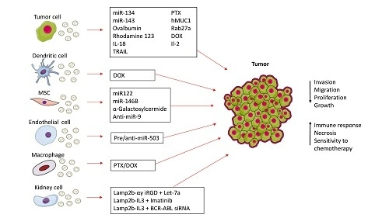
Engineering Exosomes for Cancer Therapy
Gilligan KE, Dwyer RM. (2017) Engineering Exosomes for Cancer Therapy. Int J Mol Sci 18(6).

Slide 34

Thank you for your attention!
Thanks to my EV group!
Special Thanks to Dr. Max Costa!
Shan Liu
Thank you to Dr. Chunyuan Jin for his help with the NUPR1-overexpression RNA-seq data.
Also Thanks to my mentor committee:
Dr. Suresh Cuddapah
Dr. Wei Dai
Dr. Anne Marie Schmidt
Aikaterini Stavrou

